Slide 1



Titolo presentazione sottotitolo
Travlendar+
Milano, XX mese 20XX
Design Document Authors: A. Aimi, R. Bigazzi, F. Collini

Slide 2
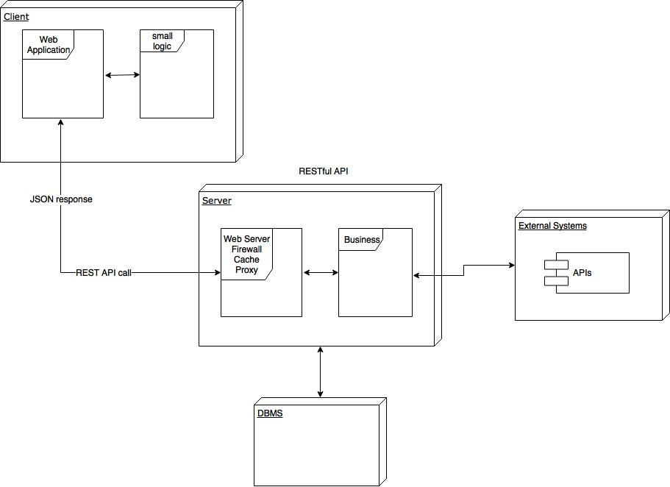
High Level

Slide 3
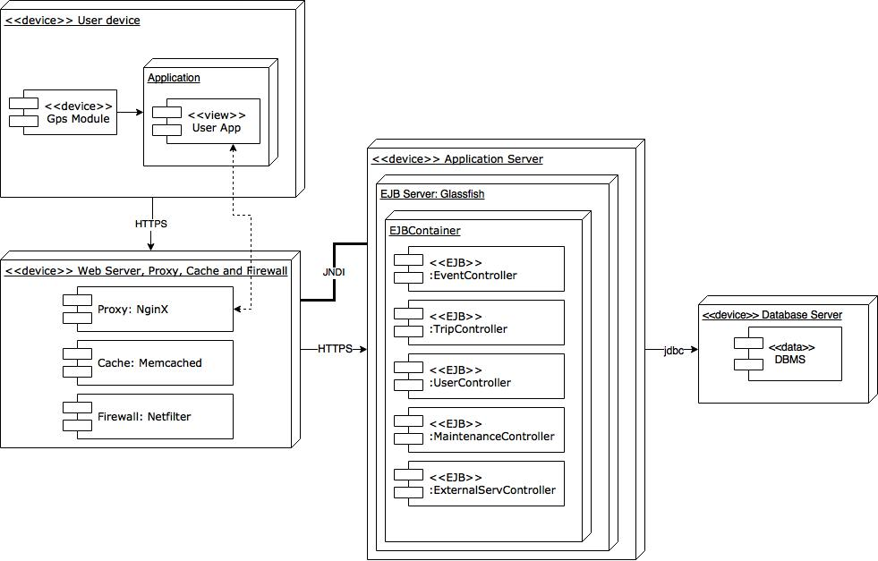
Corresponding Deployment Diagram

Slide 4
Cloud Computing and IaaS
Advantages:
Scalability
Costs
Security
Availability
Constraints:
Stateless Components
Upgrade
Maintenance

Slide 5
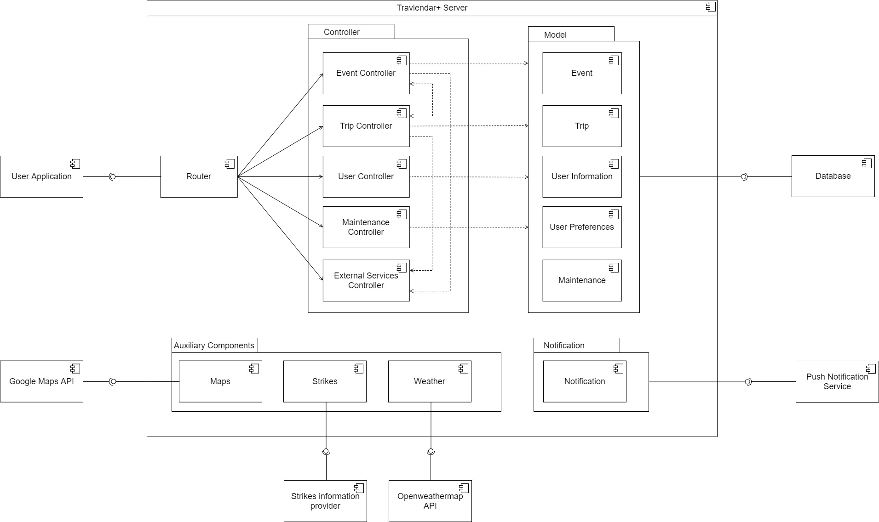
Component Diagram

Slide 6
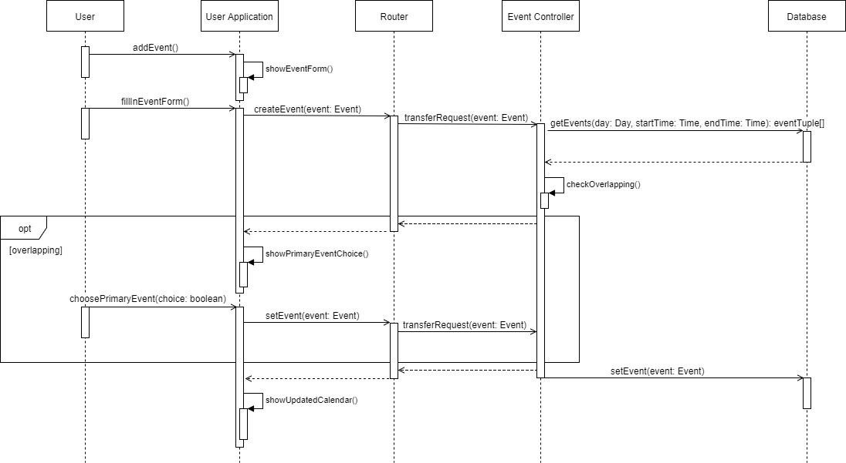
Runtime view – Add event
Runtime view

Slide 7
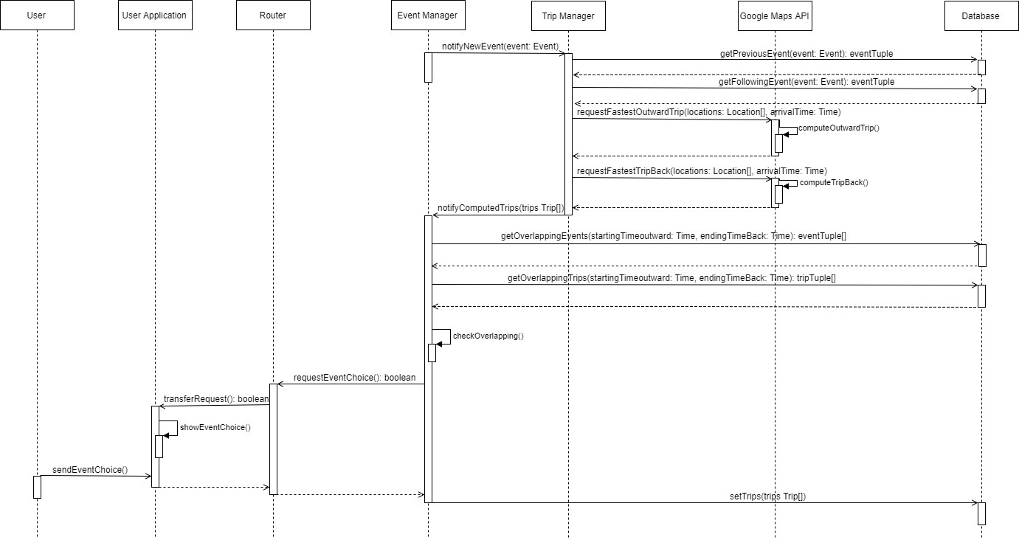
Runtime view – Trip commutation

Slide 8
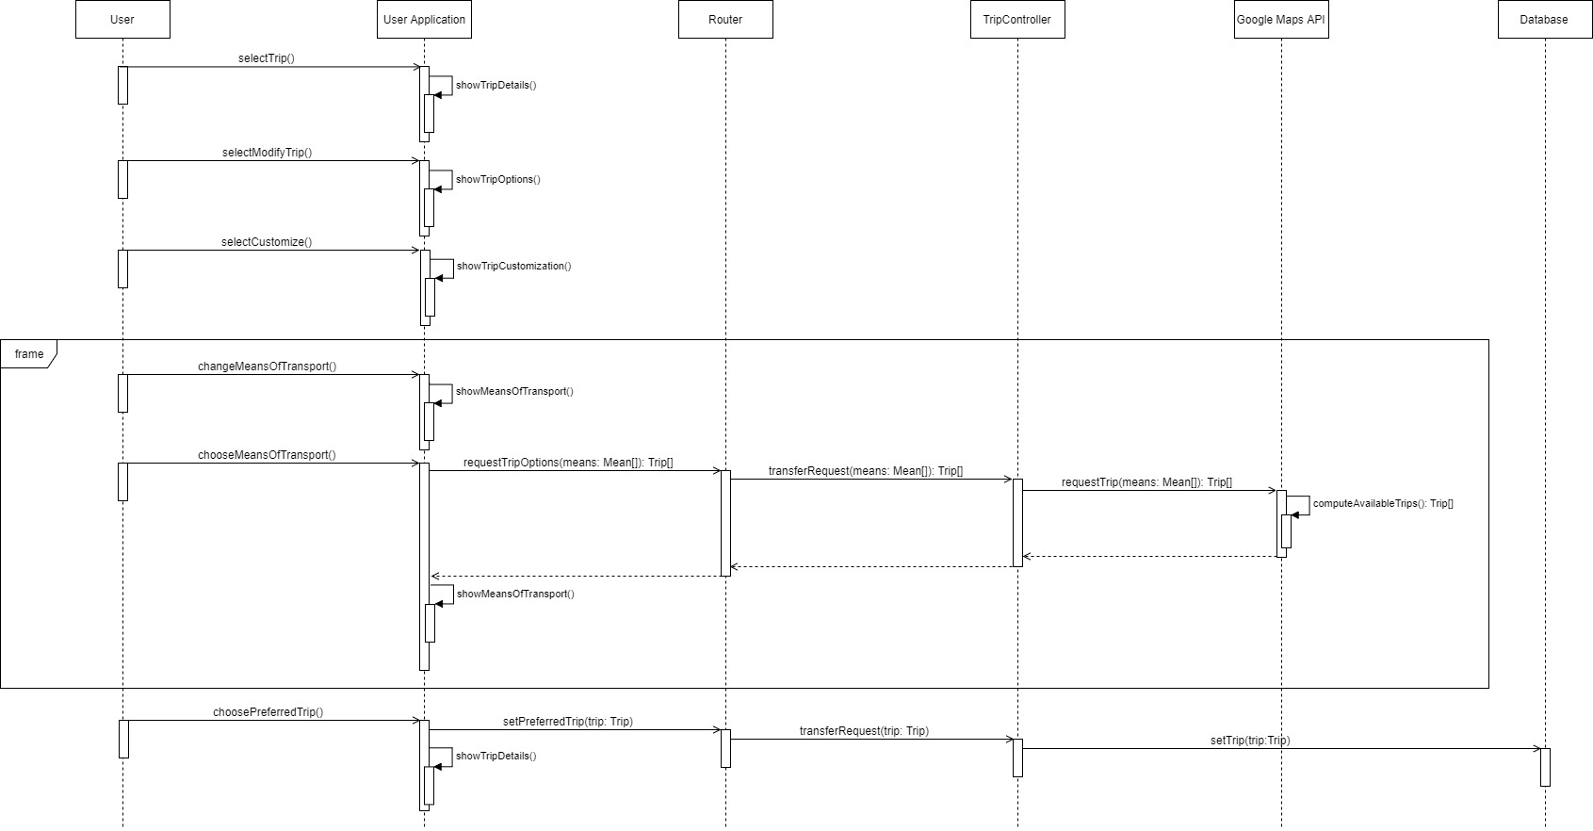
Runtime view – Trip customization

Slide 9
Main decisions
http://www.differencebetween.net/technology/software-technology/difference-between-client-server-application-and-web-application/
Break times
Primary and secondary events
APIs (payments)
Travlendar+ User interface (2 layers: Calendar/Travel)

Slide 10
Most important algorithm

Slide 11
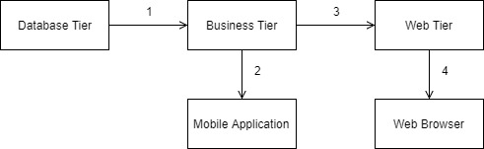
Implementation, integration and test plan

Slide 12
Implementation, integration and test plan
System composition:
Front-end components: mobile application;
Back-end components: the server and its components;
External components: the components which refer to functionalities provided by external systems and the DBMS.
Test plan:
Bottom-up strategy

